Slide 1
Product Canvas
Personal Loan Prediction based on cross-selling platform and Factors influencing the same.
Customer Segment/Lead Generation
Customer Relationship/Operations
Credit
Value Propositions/Sales
Final Disbursal
Policies
Document. Management System/Operations
FDS/Fraud Detection
Credit Score

Slide 2

What are the new things that you haven’t thought about, but others have helped you in this journey?
At first, I did not think of Prediction of customer analytics which I came to know through my friends and colleagues.
There were lot of new learnings that I learnt while building the above product canvas such as considering the factors that would influence the decision of taking a personal loan.
The most important thing that I considered were the different customer segments who would prefer taking personal loan.

Slide 3
What are the key challenges that you faced in developing Product Canvas?
Key Challenges faced in developing Product Canvas:
Factors to be considered for the eligibility of clients.
The most important challenge I faced was to determine the cut off limit for the credit score.
To determine client relationship with bank and to see if customer had previously taken loan or not.

Slide 4
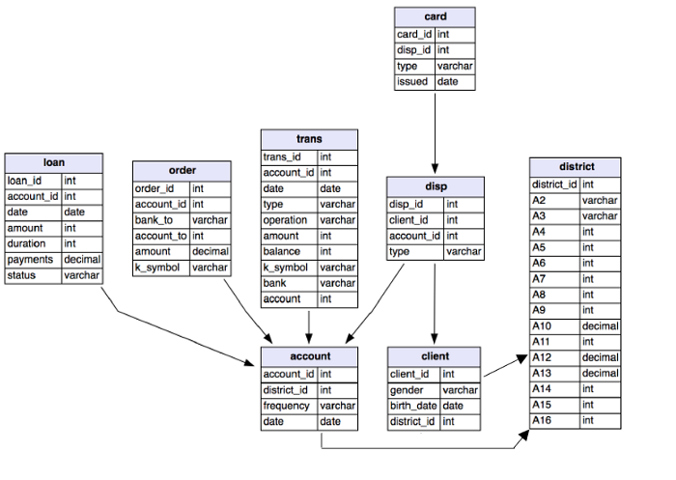
Third Normal Form
Notes:
Data has been taken from “https://medium.com/@pankajgurbani01/machine-learning-model-to-predict-loan-default-9c33f87e1a38”

Slide 5
Entity Relationship Diagram
Client name
Client Street
Loan Number
Amount
Client id
Client city
Borrower
CUSTOMER
loan

Slide 6
Challenges faced while developing conceptual model / ER Diagram
A clear context on what kind of customers to focus on while predicting the eligibility of giving clients loan.
Factors depending whether we can consider a particular client.
External factors such as verifications , multiple background checks needs to be carried out before we process application.
The key issue was predicting in what kind of clients to choose from.

Slide 7
Develop analytical questions that lead to addressing end state of your product idea

Slide 8
Develop the linkage tables between these questions and Data Sources

Slide 9
How can we potentially answer these questions? What data could be of help for further analysis?

Slide 10
Map these questions against Entities to validate if we will be able to answer the questions hypothetically or do we need to tap into other data sources

